Slide 1



Credit Card Customer Attrition
View in Power BI
Last data refresh:
11/25/2021 12:44:01 PM UTC
Downloaded at:
1/17/2022 12:12:24 PM UTC

Slide 2
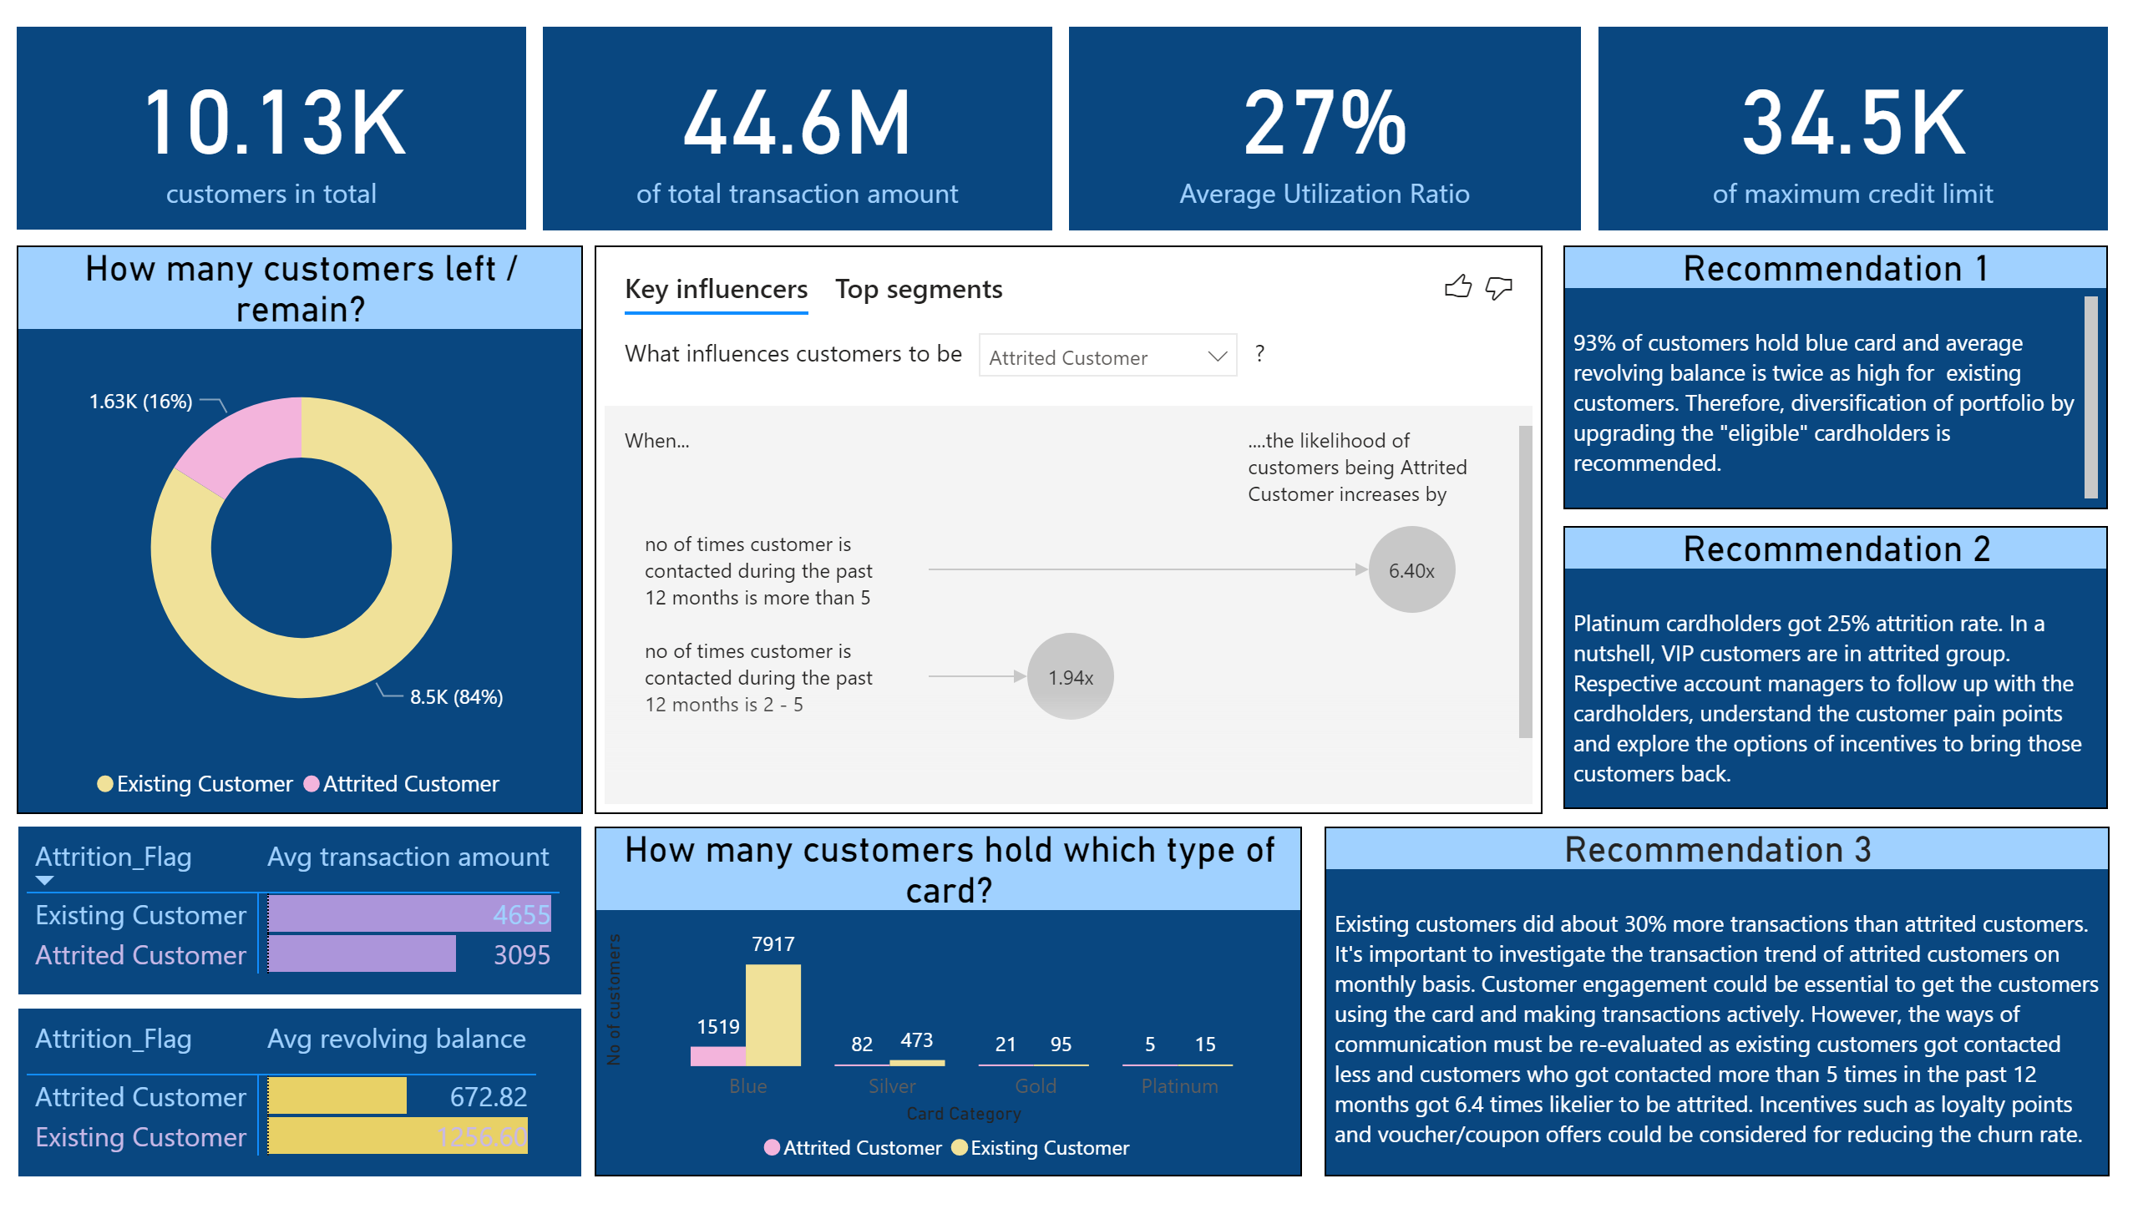
Overview
Notes:
How many customers left / remain?
No alt text provided
How many customers hold which type of card?
No alt text provided
card
No alt text provided
card
No alt text provided
Average Utilization Ratio
No alt text provided
card
No alt text provided
keyDriversVisual
No alt text provided
pivotTable
No alt text provided
pivotTable
No alt text provided
Recommendation 1
No alt text provided
Recommendation 2
No alt text provided
Recommendation 3
No alt text provided

